Slide 1
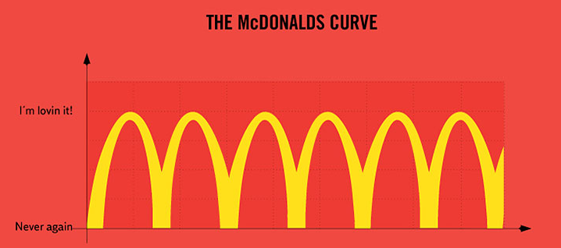
Agenda:
Bell Work:
1. What was your favorite thing that you did over October break?
2. What confuses you about graphing? If you cannot thin of something that confuses you then answer the following questions:
a. What axes do the independent and dependent variable go
on (x or y-axes)?
b. What type of graph do you make for data collected over time?
c. What does it mean to “scale your data”?
d. What type of graph do you make for groups of data?
Review academic integrity policy
Review importance of following instructions (especially during an exam)
Review scaling data and steps on how to make a graph
Return a billion things while you guys use the remainder of class time to prepare for exam re-take tomorrow

Slide 2
Talk to your shoulder buddy! Record your answer to the following questions with your bell work for today!
What do you think “academic integrity” means?

Slide 3
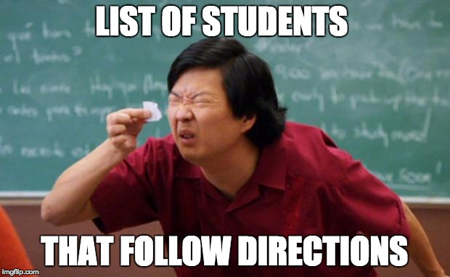
Talk to your shoulder buddy! Record your answer to the following questions with your bell work for today!
Why is it important to LISTEN TOO and FOLLOW your teacher’s instructions ESPECIALLY during an exam?

Slide 4
Steps for graphing
Determine the type of data you have: group data, data collected over time, or percentage data.
Decide which type of graph you will use: a bar graph, a line graph, or a pie graph.
Choose the appropriate scale for the data if you are going to make a bar graph or a line graph.
Include all the required components of your graph type.
See notes page 2 - 4 for required components

Slide 5
WATER BOTTLES LOST PER SCHOOL YEAR
Number of H₂O bottles | School year
35 | 2016
60 | 2017
50 | 2018
55 | 2019
25 | 2020
40 | 2021

Slide 6
DISEASES KIDS PRETEND THEY HAVE TO GET OUT OF ATTENDING SCHOOL (BASIS CHANDLER)
Number of kids | Fake diseases
500 | Cold
500 | Flu
200 | Step throat
400 | Diarrhea

Slide 7
NUMBER OF TIMES MRS. GBUREK TALKS ABOUT JEYRGE PICKLESTON PER HOUR DURING SCHOOL
Jeyrge Pickleston references | Hour since school started
5 | 1
15 | 2
20 | 3
10 | 4
15 | 5
20 | 6
25 | 7
30 | 8

Slide 8
REASONS I LOST MY HOMEWORK AT BASIS CHANDLER
# of kids | Homework loss reason
150 | Dog ate it
150 | I forgot
200 | My little brother peed on it
350 | It spontaneously combusted
550 | Why didn’t you tell us we had homework Mrs G? (even though it’s been on the CJ ALL WEEK LONG)!

Slide 9
FREE CLASS TIME!!!
Whiteboard review to prepare for exam
Graphing worksheets!
Review study guide!

