Slide 1
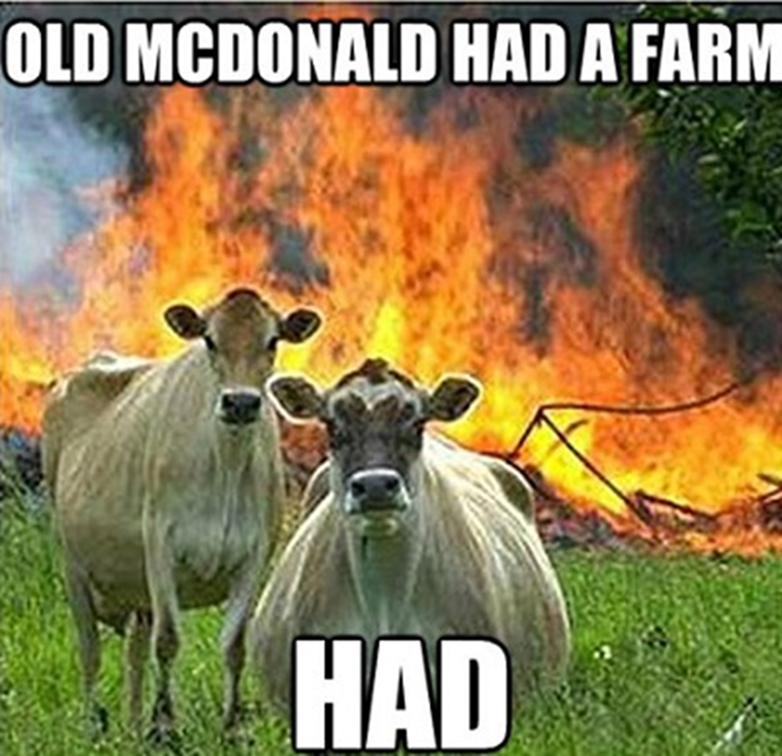
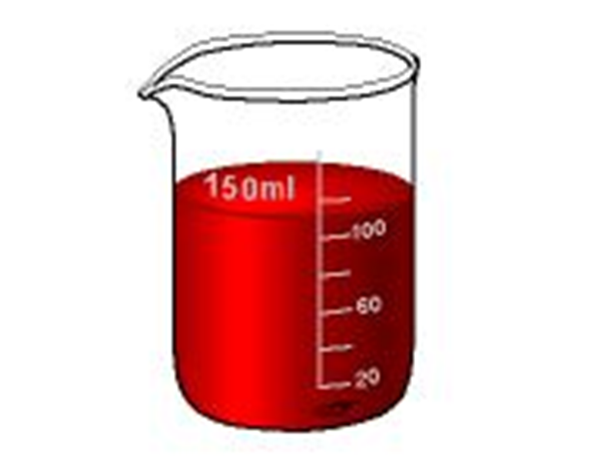
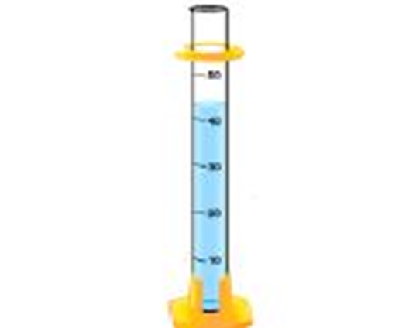
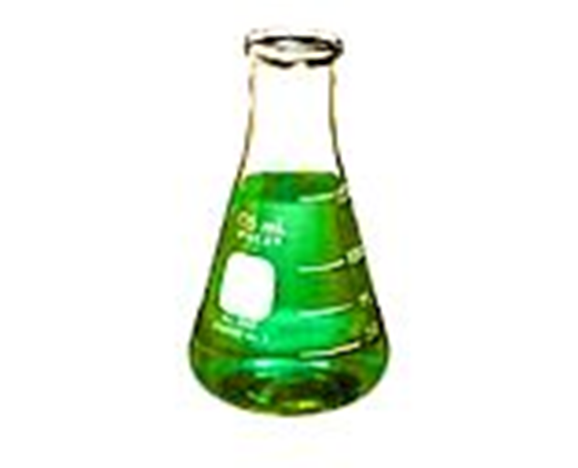
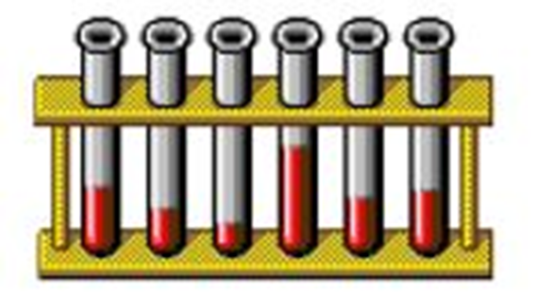
Agenda:
Bell Work
Check exam score signatures
Start Lab equipment and measurement unit notes
Identify each of the pieces of lab equipment and describe how they are used:
1.
2.
3.
4. & 5.
BEAKER - Used to measure out large volumes of liquids
For example 20mL, 40mL, 60mL, 80mL, 100mL
GRADUATED CYLINDER - Used to measure out small, specific amounts of liquid
For example, 11mL, 46mL, 52mL
ERLENMEYER FLASK - Used for measuring large amounts of liquid that can be mixed by swirling without spillage
TEST TUBE - Used to hold, mix, or heat small quantities of solid or liquid chemicals
RACK - Used to hold several test tubes in one place

Slide 2
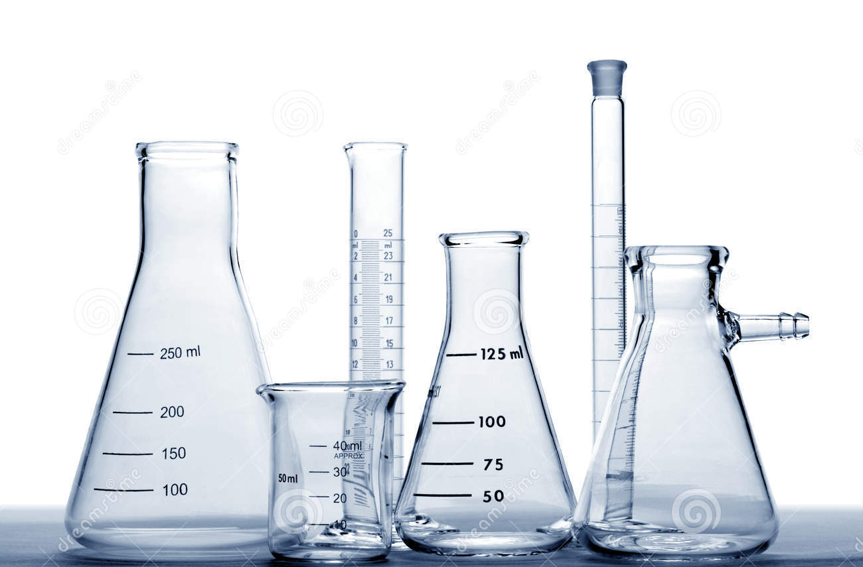
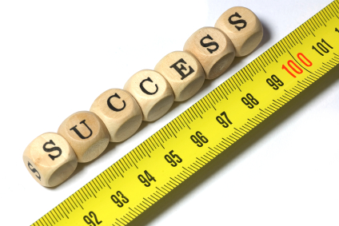
Unit 3: Lab Equipment and Measurement!!!

Slide 3
Equipment identification and Use
Beaker
Used to measure out large volumes of liquids
For example 20mL, 40mL, 60mL, 80mL, 100mL

Slide 4
Equipment identification and Use
Graduated Cylinder
Used to measure out small, specific amounts of liquid
For example, 11mL, 46mL, 52mL

Slide 5
Equipment identification and Use
Erlenmeyer flask
Used for measuring large amounts of liquid that can be mixed by swirling without spillage

Slide 6
Equipment identification and Use
Test tubes
Used to hold, mix, or heat small quantities of solid or liquid chemicals
Test tube rack
Used to hold several test tubes in one place

Slide 7
Equipment identification and Use
Hot plate
Used to heat substances without using an open flame

Slide 8
Equipment identification and Use
Safety goggles
Protects scientists eyes from chemicals and flying objects

Slide 9
Equipment identification and Use
Lab tongs
Used for grasping or lifting lab materials
Specifically used for lifting beakers containing corrosive or hot materials

Slide 10
Equipment identification and Use
Electronic balance
Used to weigh out very specific amounts of a substance in grams

Slide 11
Equipment identification and Use
Ring stand
Used to suspend beakers, flasks, or test tubes

Slide 12
Equipment identification and Use
Test tube tongs
Used to hold test tubes containing corrosive or hot chemicals

Slide 13
Equipment identification and Use
Pipettes
Used for measuring out VERY small amounts of liquids
For example, 0.5mL, 1mL, 3.5mL

Slide 14
Equipment identification and Use
Funnel
Pouring liquids into containers with small openings without spilling

Slide 15
Equipment identification and Use
Thermometer
Used to measure the temperature of a substance

Slide 16
Use the next 5 minutes to answer the following questions on page 3 in your note packet with your shoulder buddy!

Slide 17
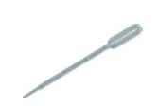
Equipment Questions
MASS!!!
What does a balance measure?
List 3 pieces of lab equipment designed to measure volume.
What does a thermometer measure?
ERLENMEYER FLASK!!!
GRADUATED CYLINDER!!!
BEAKER!!!
PIPETT!!!
TEMPERATURE!!!

Slide 18
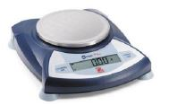
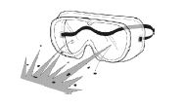
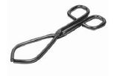
Equipment Questions
4. Which piece of laboratory equipment should you use for the following tasks:
Hot plate!!!
Heating water without using an open flame.
Measuring out exactly 43 mL of water.
Weighing out 120 grams of sodium chloride.
Protecting your eyes from chemicals, flying objects, etc.
Holding a beaker full of hot liquid.
Graduated cylinder!!!
Electronic balance!!!
Safety goggles!!!
Lab tongs!!!

Slide 19
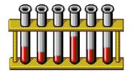
Equipment Questions
Which piece of laboratory equipment should you use for the following tasks:
Pouring liquids into containers with small openings.
Measuring very small amounts of liquid.
Holding test tubes.
Hold several test tubes in one place.
Funnel!!!
Pipette!!!
Test tube tongs!!!
Test tube rack!!!

Slide 20
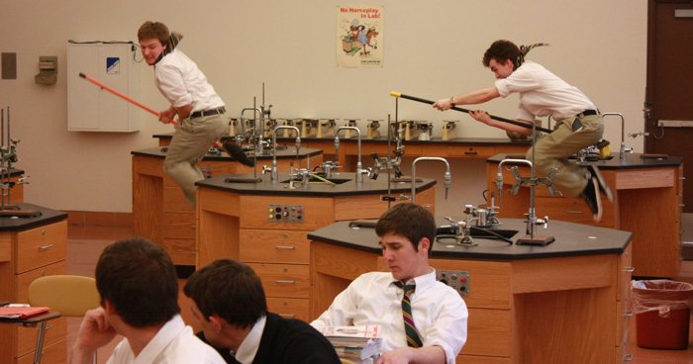
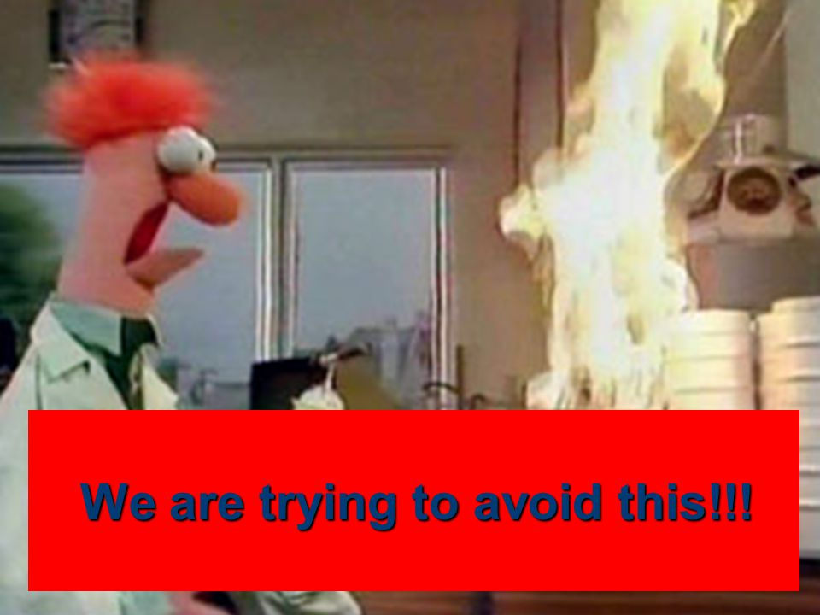
Lab Safety
Rule #1: Never touch anything unless instructed to do so by the teacher!!!
Rule #2: Horseplay in the lab will get you kicked out of the lab.
Rule #3: Using equipment other than its intended purpose will get you kicked out of the lab.

Slide 21
Class time left???
White board review
Word games from the back table

