Slide 1
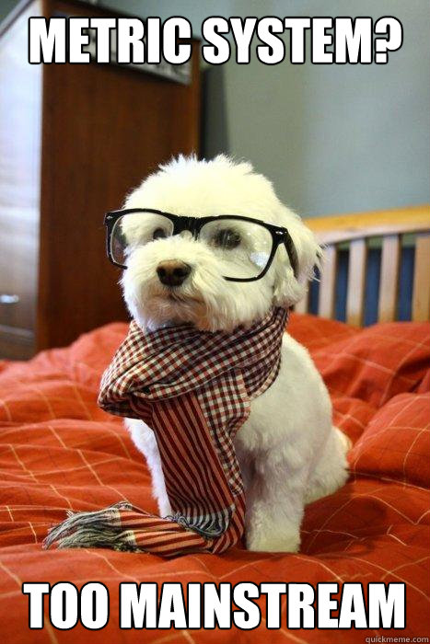
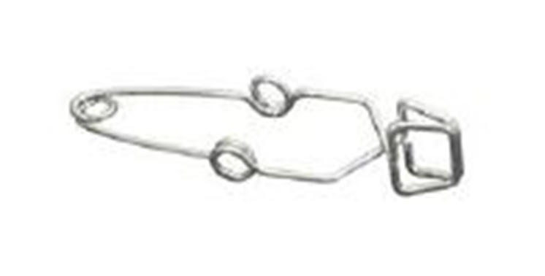
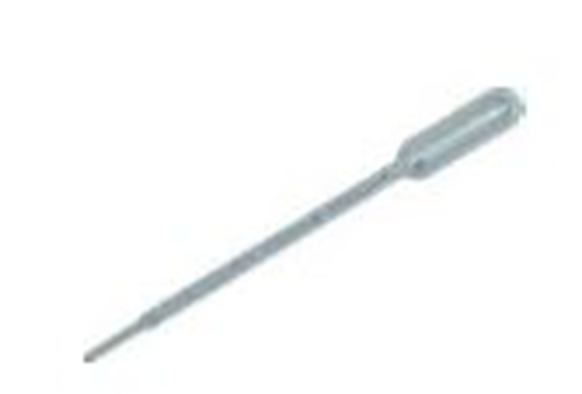
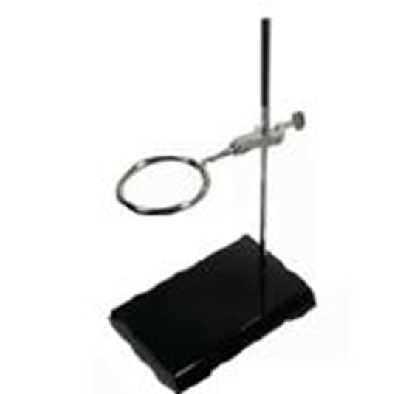
Agenda:
Bell Work
Continue notes
Start making measurements activity
Identify each of the pieces of lab equipment and describe how they are used:
1.
2.
3.
4.
TEST TUBE TONGS - Used to hold test tubes containing corrosive or hot chemicals
PIPETTE - Used for measuring out VERY small amounts of liquids, for example, 0.5mL, 1mL, 3.5mL
RING STAND - Used to suspend beakers, flasks, or test tubes
FUNNEL - Pouring liquids into containers with small openings without spilling

Slide 2
Equipment Questions
4. Which piece of laboratory equipment should you use for the following tasks:
Heating water without using an open flame.
Measuring out exactly 43 mL of water.
Weighing out 120 grams of sodium chloride.
Protecting your eyes from chemicals, flying objects, etc.
Holding a beaker full of hot liquid.
Pouring liquids into containers with small openings.
Measuring very small amounts of liquid.
Holding only ONE test tube.
Hold several test tubes in one place.
What does a balance measure?
List 3 pieces of lab equipment designed to measure volume.
What does a thermometer measure?

Slide 3
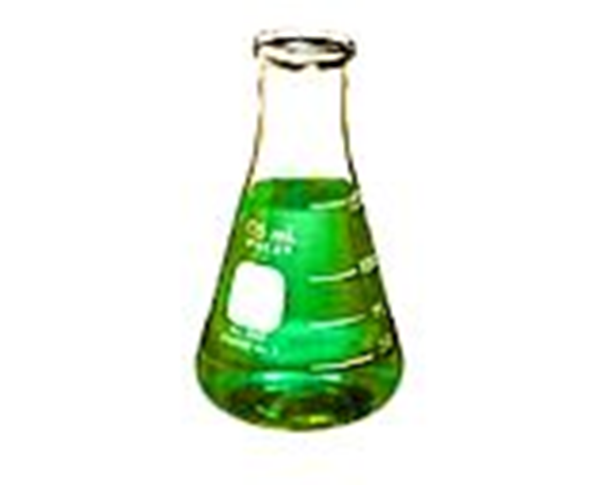
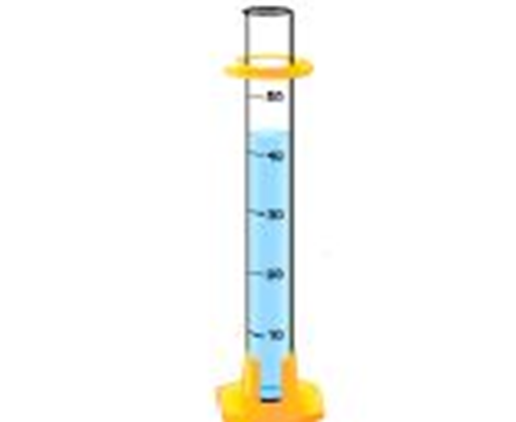
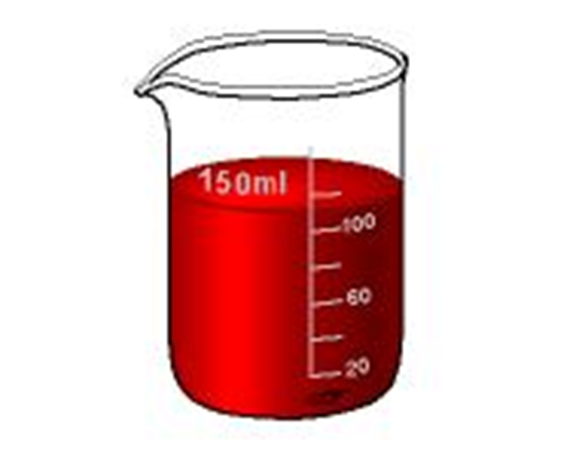
Equipment Questions
MASS!!!
What does a balance measure?
List 3 pieces of lab equipment designed to measure volume.
What does a thermometer measure?
ERLENMEYER FLASK!!!
GRADUATED CYLINDER!!!
BEAKER!!!
PIPETT!!!
TEMPERATURE!!!

Slide 4
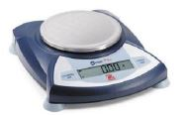
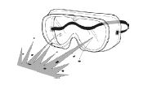
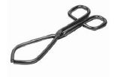
Equipment Questions
4. Which piece of laboratory equipment should you use for the following tasks:
Hot plate!!!
Heating water without using an open flame.
Measuring out exactly 43 mL of water.
Weighing out 120 grams of sodium chloride.
Protecting your eyes from chemicals, flying objects, etc.
Holding a beaker full of hot liquid.
Graduated cylinder!!!
Electronic balance!!!
Safety goggles!!!
Lab tongs!!!

Slide 5
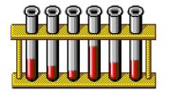
Equipment Questions
Which piece of laboratory equipment should you use for the following tasks:
Pouring liquids into containers with small openings.
Measuring very small amounts of liquid.
Holding only ONE test tube.
Hold several test tubes in one place.
Funnel!!!
Pipette!!!
Test tube tongs!!!
Test tube rack!!!

Slide 6
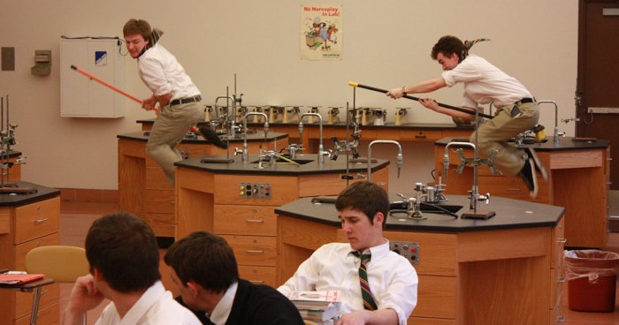
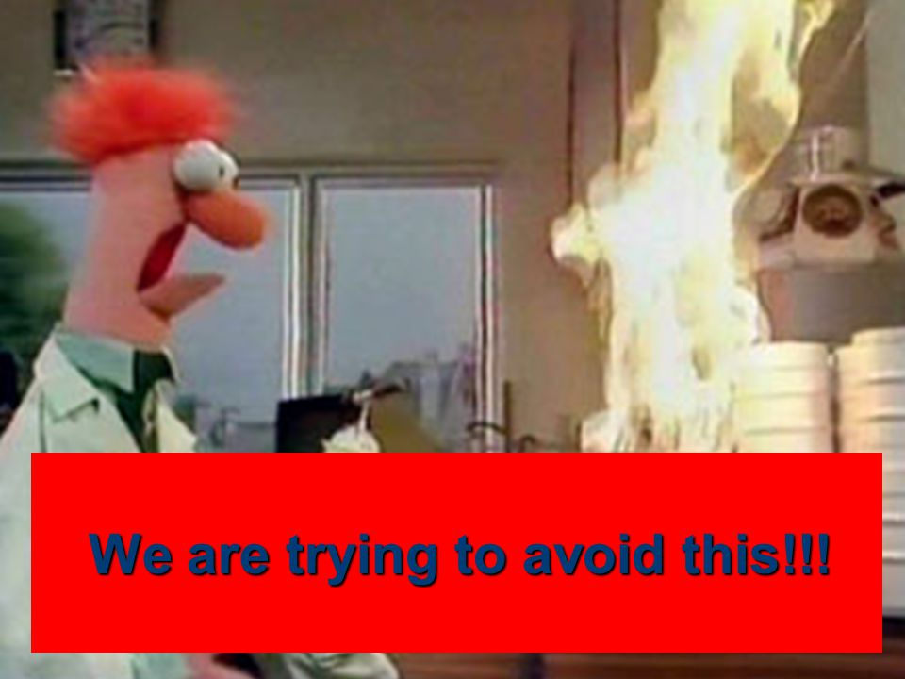
Lab Safety
Rule #1: Never touch anything unless instructed to do so by the teacher!!!
Rule #2: Horseplay in the lab will get you kicked out of the lab.
Rule #3: Using equipment other than its intended purpose will get you kicked out of the lab.

Slide 7
Metric Measurements and Conversions
The beauty of the metric system that it is a system based on the number 10.
Unit conversions using the stair-step method: Fill in the boxes for the stair step diagram.
u up-stairs
Mnemonic:
k King
h Henry
d(a) died
d drinking
c chocolate
m milk
To convert to a smaller unit, move the decimal to the right or multiply by 10
To convert to a larger unit, move the decimal to the left or divide by 10

Slide 8
Metric Measurements and Conversions
To convert to a smaller unit, move the decimal to the right or multiply by 10
To convert to a larger unit, move the decimal to the left or divide by 10
4000
Example: 4 km = __________m
How many “jumps” does it take?
4.____._____._____. = 4000 m
How to use the stair-step method:
Determine your starting point.
Count the “jumps” to your ending point.
Move the decimal the same number of “jumps” in the same direction.
Starting point
Ending point
0
0
0
1
2
3

Slide 9
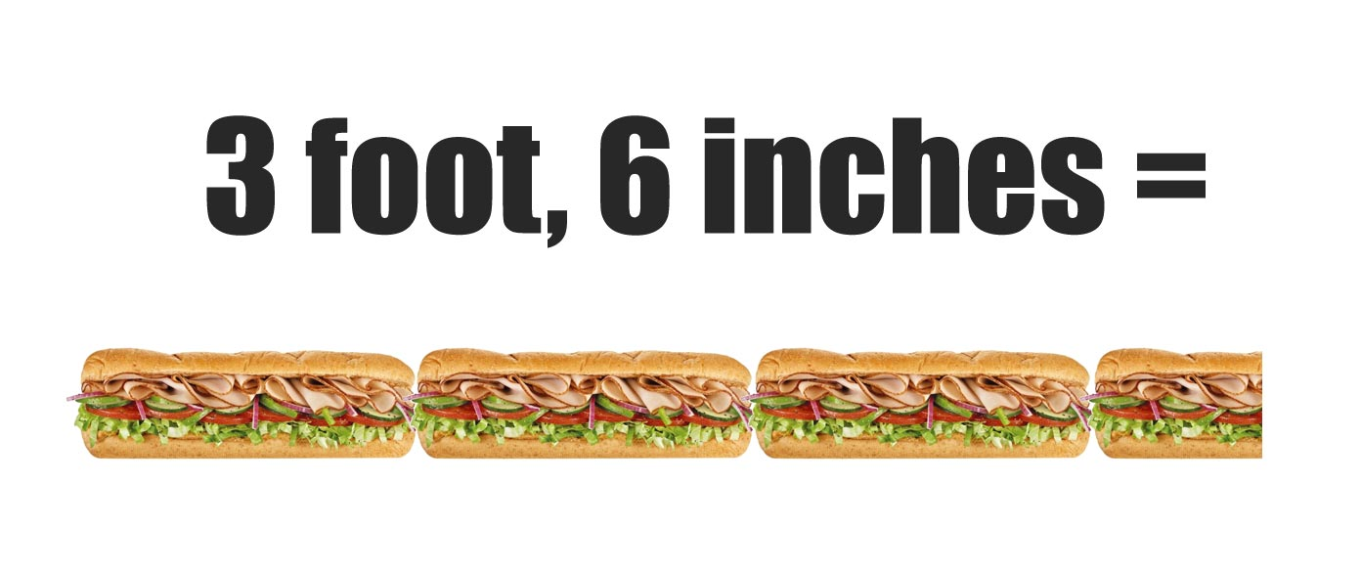
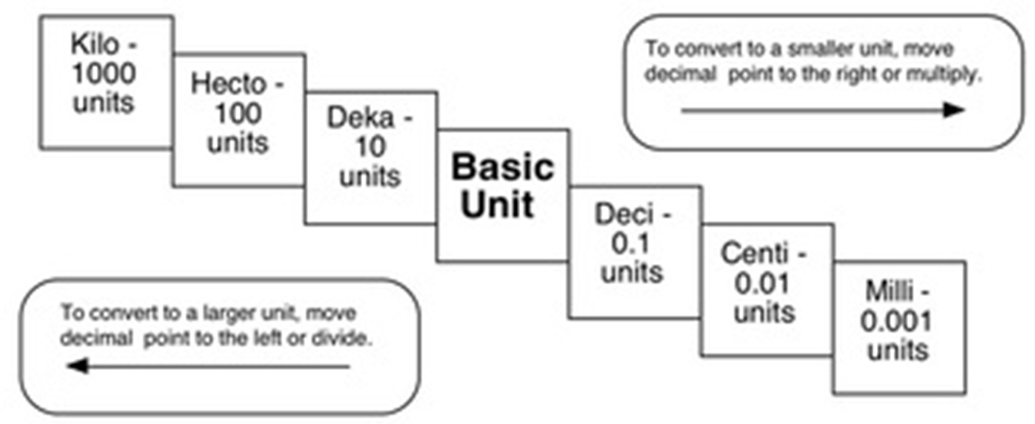
Try these conversions using the stair-step method:
1000 mg = 1 g 1 L = 1000 mL 160 cm = 1600 mm
14 km = 14000 m 109 g = 0.109 kg 250 m = 0.25 km

Slide 10
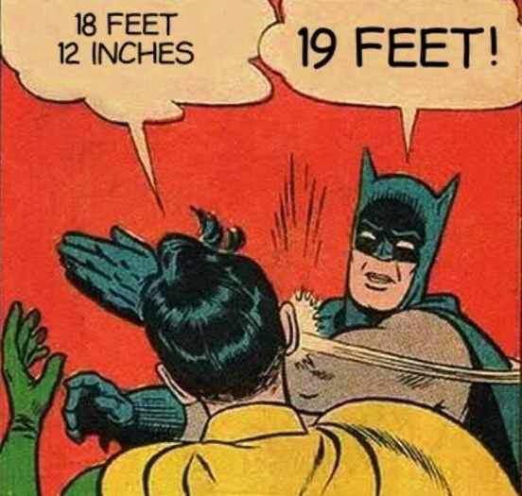
Compare the following using <, >, or =
HINT! Convert one of the values to the same units as the other value before comparing!!!
56 cg = 0.56 g
36 dm = 360 cm
5 km = 5000 m
56 cg < 6 g 36 dm > 3.6 cm 5 km > 508 m
1500 mL < 15 L 7 g > 698 mg 63 cm < 6 m
1500 mL = 1.5 L
7 g = 7000 mg
63 cm = 0.63 m

Slide 11
Making Measurements Activity!
cm = centimeters
mm = millimeters
k h da u d c m

Slide 12
Class time left???
White board review
Word games from the back table

