Slide 1
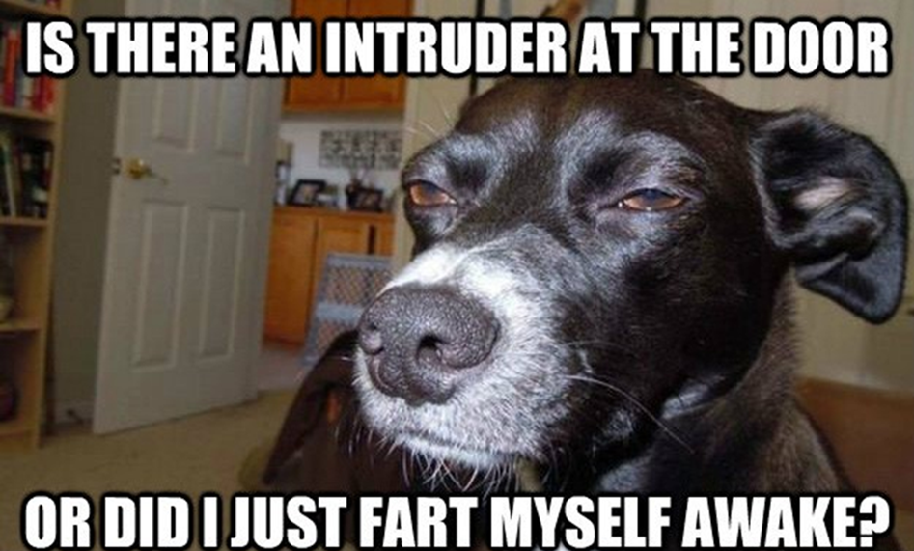
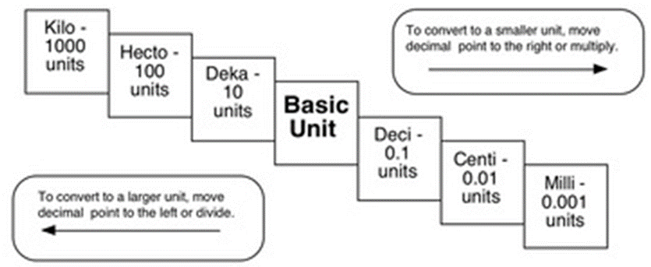
Agenda:
Bell Work
Continue notes
Making measurements activity!!!
Use the stair step method to make the metric conversions below:
4.5cm = _____ dm 100m = ______ km
0.567 mL = _________ daL
9 hg = ____ kg 0.12 hg = _____dag
1 mL = _________ kL
5km = _________ mm
1)
0.45
2)
0.1
3)
0.0000567
4)
0.9
5)
1.2
0.000001
6)
7)
5,000,000

Slide 2
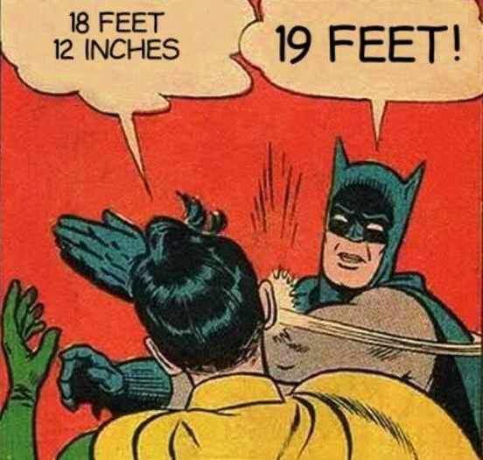
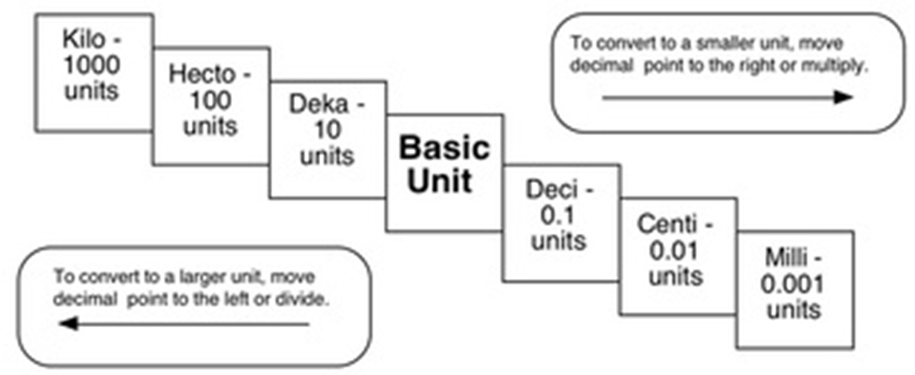
Compare the following using <, >, or =
HINT! Convert one of the values to the same units as the other value before comparing!!!
56 cg = 0.56 g
36 dm = 360 cm
5 km = 5000 m
56 cg < 6 g 36 dm > 3.6 cm 5 km > 508 m
1500 mL < 15 L 7 g > 698 mg 63 cm < 6 m
1500 mL = 1.5 L
7 g = 7000 mg
63 cm = 0.63 m

Slide 3
Making Measurements Activity!
cm = centimeters
mm = millimeters
k h da u d c m

Slide 4
Class time left???
White board review
Word games from the back table

