Slide 1
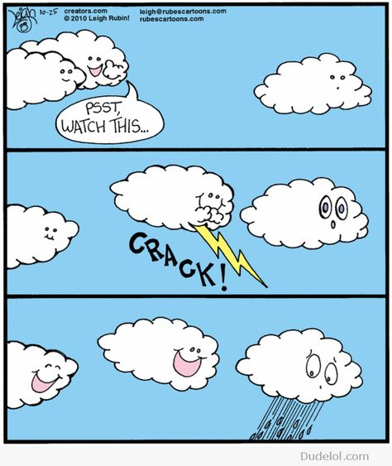
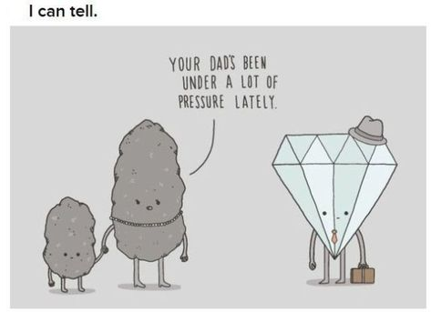
1.Please have out your completed “Life as a Drip” assignment
2. Based on your experience as a “drip”, where does it take water molecules the LONGEST to cycle through?
AGENDA:
BELLWORK
Collect “Life as a drip” assignment
Niathi current events
Discuss video opportunity
Explore scienceteacherg.com
Return exams
Class time to work on exam corrections

Slide 2
OCEAN ACIDIFICATION

Slide 3
What is Ocean Acidification
When carbon dioxide from the atmosphere dissolves into seawater, the seawater and carbon dioxide will combine to form carbonic acid(H2CO3)
The carbonic acid will then dissociate into hydrogen ions(H+) and bicarbonate ions(HCO3)
The more Hydrogen ions in the ocean, the more the pH will decrease making the seawater more acidic
Right now, the average pH of the ocean is 8.1, which is basic for an alkaline, but studies show that by the end of the century, surface waters of the ocean will decline to a pH of around 7.8

Slide 4
What’s causing it?
Since the industrial revolution, there has been a steady anthropogenic increase in carbon dioxide in our atmosphere
  Since the revolution, the pH of surface ocean waters has decreased by 0.1 pH units which is about a 30 percent increase in acidity
About 30% of the carbon dioxide in the atmosphere is absorbed by the ocean, so as carbon dioxide concentrations in the atmosphere increase, the ocean will absorb more CO2. The more CO2 there is, the more hydrogen ions therefore making the ocean more acidic
This CO2 concentration increase has been mainly caused
by human actions such as:
    Burning fossil fuels
    Changing land use
Notes:
Burning fossil fuels->car emissions
Changing land use-> deforestation, net loss of forest and other land areas
Since industrial revolution, pH of surface ocean waters has decreased by 0.1 pH units which is about a 30 percent increase in acidity
The ocean takes in 30% of the carbon dioxide (CO2) that is released in the atmosphere. As CO2 increases from human activity(burning fossil fuels (e.g., car emissions) and changing land use (e.g., deforestation),oceans absorbs more CO2. seawater taking in CO2->chemical reactions->more H+ ions which means acidity increases and pH decreases

Slide 5
What areas are most affected?
A 2015 study showed that the Pacific Northwest, Long Island Sound, Narragansett Bay, Chesapeake Bay, the Gulf of Mexico, and areas off Maine and Massachusetts were hot spots
It also severely harms Alaskan fisheries which provide almost 60% of the US’s commercial fish and provide more than 100,000 jobs
It’s also a concern for the Great Barrier reef as corals have been steadily declining over the last 30 years decreasing habitat
area

Slide 6
Impacts on Shell Builders
As the ocean water gets more acidic, there will be fewer carbonate ions because the available carbonate ions will bond with the excess hydrogen in a more acidic ocean
When there are fewer carbonate ions, it will be harder for
organisms to build and maintain their carbonate structures
such as shells and skeletons
Even if organisms are able to build skeletons, it will require more energy taking resources away from other essential activities
In some cases, the shells and skeletons will begin to
dissolve if the pH gets too low
Notes:
Oysters and coral and mussells
Shell-building organisms can't extract the carbonate ion they need from bicarbonate, preventing them from using that carbonate to grow new shell.

Slide 7
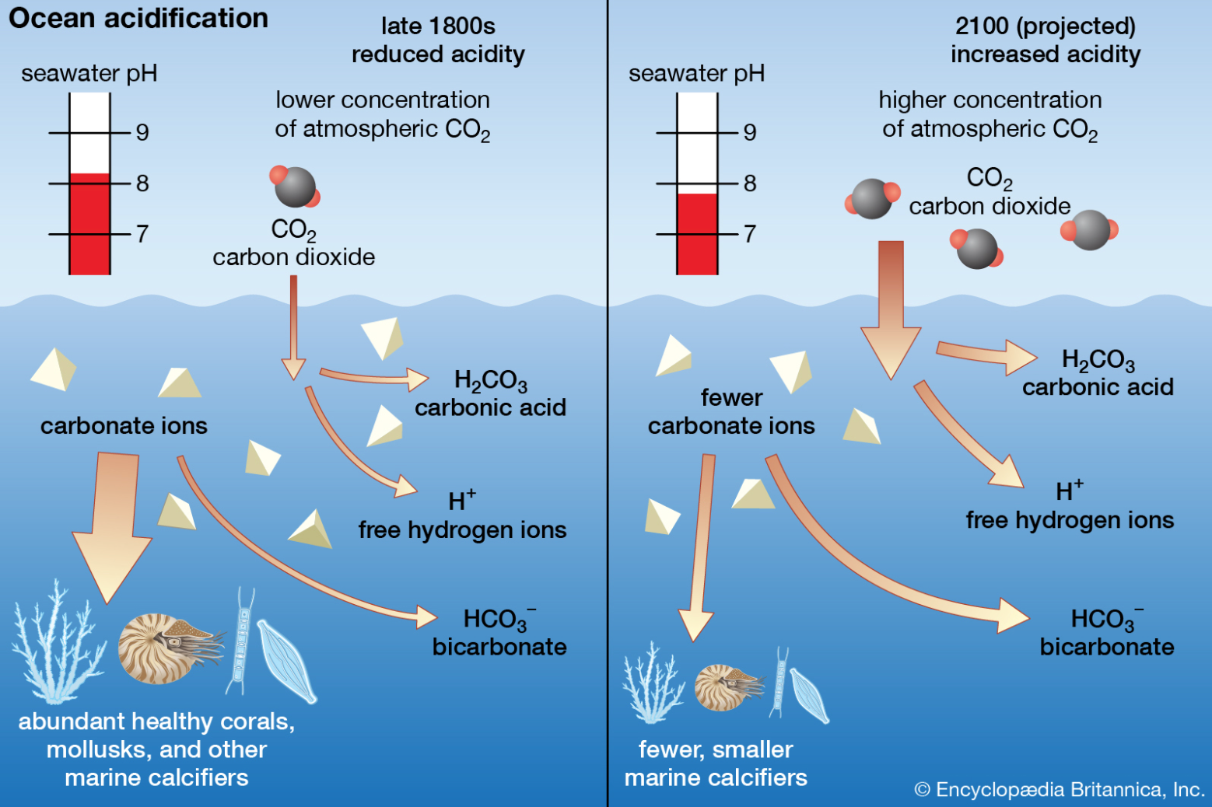
THE SLIDE TITLE GOES HERE!
Do you know what helps you make your point clear? Lists like this one:
Because they’re simple
You can organize your ideas clearly
You’ll never forget to buy milk again!
And the most important thing: the audience won’t miss the point of your presentation

Slide 8
Impacts on fish, algae, and seagrasses
When acidification increases, fish, such as clownfish, have a harder time detecting predators
Larval clownfish can’t find a suitable habitat
When these organisms are at risk, there’ll be a chain reaction that will affect the whole food web
Although many species are harmed by the increase in acidification, algae and segrasses benefit due to the influx of CO2, a reactant needed for photosynthesis
Notes:
Photosynthetic plants such as algae and seagrass benefit cause they need CO2 for photosynthesis

Slide 9
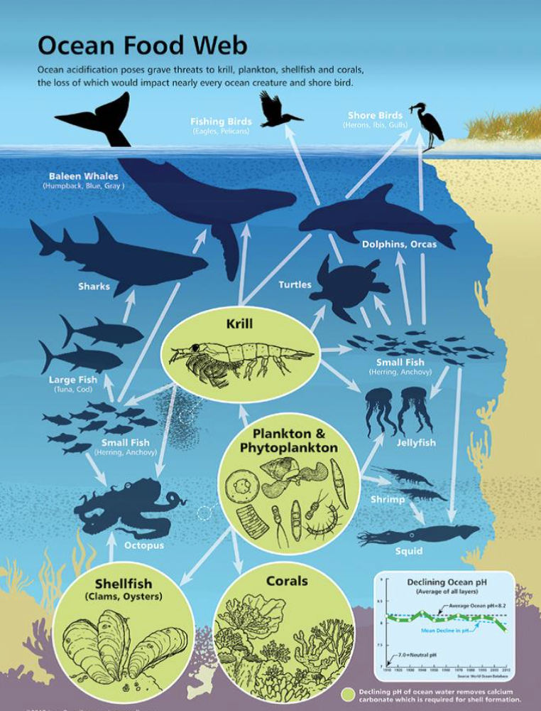
MAYBE YOU NEED TO DIVIDE THE CONTENT
Notes:
many harmful algal species produce more toxins and bloom faster in acidified waters. A similar response in the wild could harm people eating contaminated shellfish and sicken fish and marine mammals...shellfish=billion dollar industry

Slide 10
Impacts on coral reefs
Acidification can cause coral reefs to corrode and can inhibit and slow down growth
  The weaker reefs that result will also be more vulnerable to erosion
    A recent study shows that by 2080, the ocean will be so acidic that healthy reefs will erode faster than they can be rebuilt
Acidification not only harms the reefs, but also the larvae of a few coral species. In acidic waters, larvae have difficulty finding a place
to settle preventing them from reaching adulthood

Slide 11
How are humans affected?
Most of the shellfish we eat require calcium carbonate for their shells, so ocean acidification directly harms the food we eat
  Not only do we eat shellfish, we also eat animals that depend on these shellfish. So, when these shellfish are harmed, two sources of food for humans decrease
Coral reefs are imperative to humans because they provide us food, medicine, and money from tourism
Notes:
It will affect the food we eat since most of our shellfish requires calcium carbonate to form or to fortify their shells. ... The presence of healthy coral reefs is imperative to our survival because we rely on them for food, coastal protection, medicines and tourism dollars.
Many of the fish we eat are also dependent on shelled animals for their food source,

Slide 12
Discussion Questions
How can we get humans to care about ocean acidification?
What actions could the government take to help?
How does this issue relate to climate change and what are
solutions that could help both issues?

Slide 13
Sources
https://www.noaa.gov/education/resource-collections/ocean-coasts/ocean-acidification,
https://ocean.si.edu/ocean-life/invertebrates/ocean-acidification
https://www.fisheries.noaa.gov/insight/understanding-ocean-acidification

Slide 14

OPTIONAL MAKE A VIDEO OPPORTUNITY!!!
Can earn MONEY for winning!
If you participate you will earn two exam scores worth 100%!!!
Let’s check out the website!
  https://www.worldof7billion.org/student-video-contest/

Slide 15

EXAM CORRECTIONS!
Follow the instructions on the correction hand-out
You may use the key, your notes, a book, your friends, your amazing teacher!!!
You do NOT get to keep your exam for copyright purposes
Mrs. G will put the answers to #5, 6, 8, 16, and 17 on the white board

